Slide 1
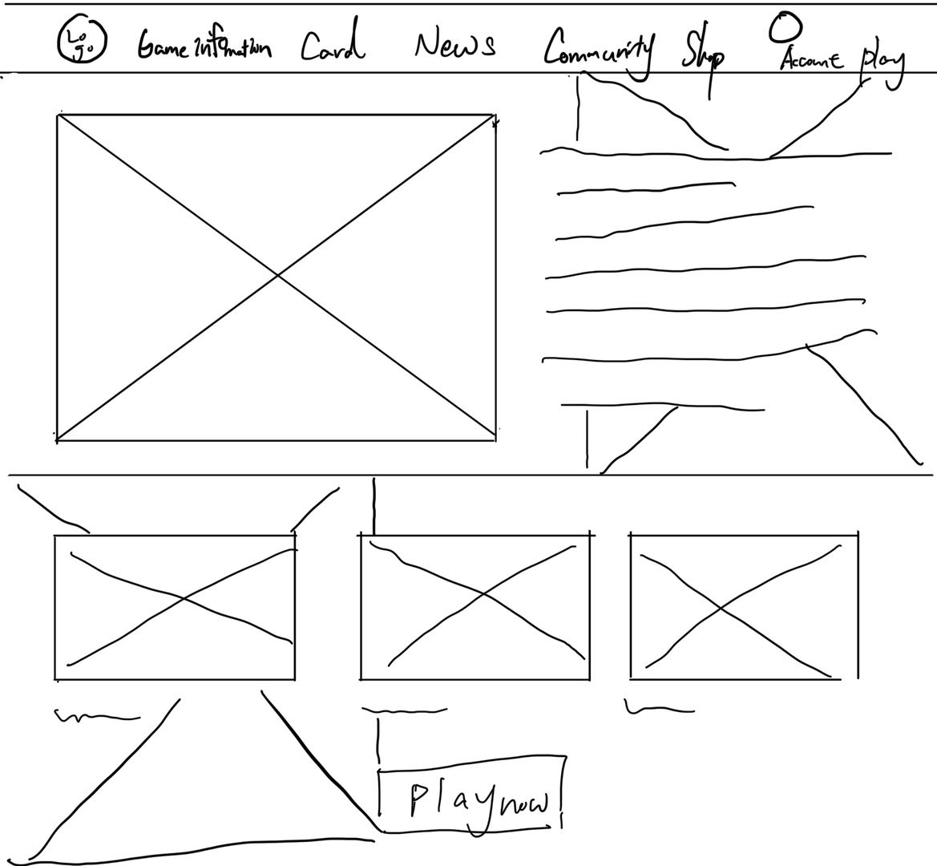
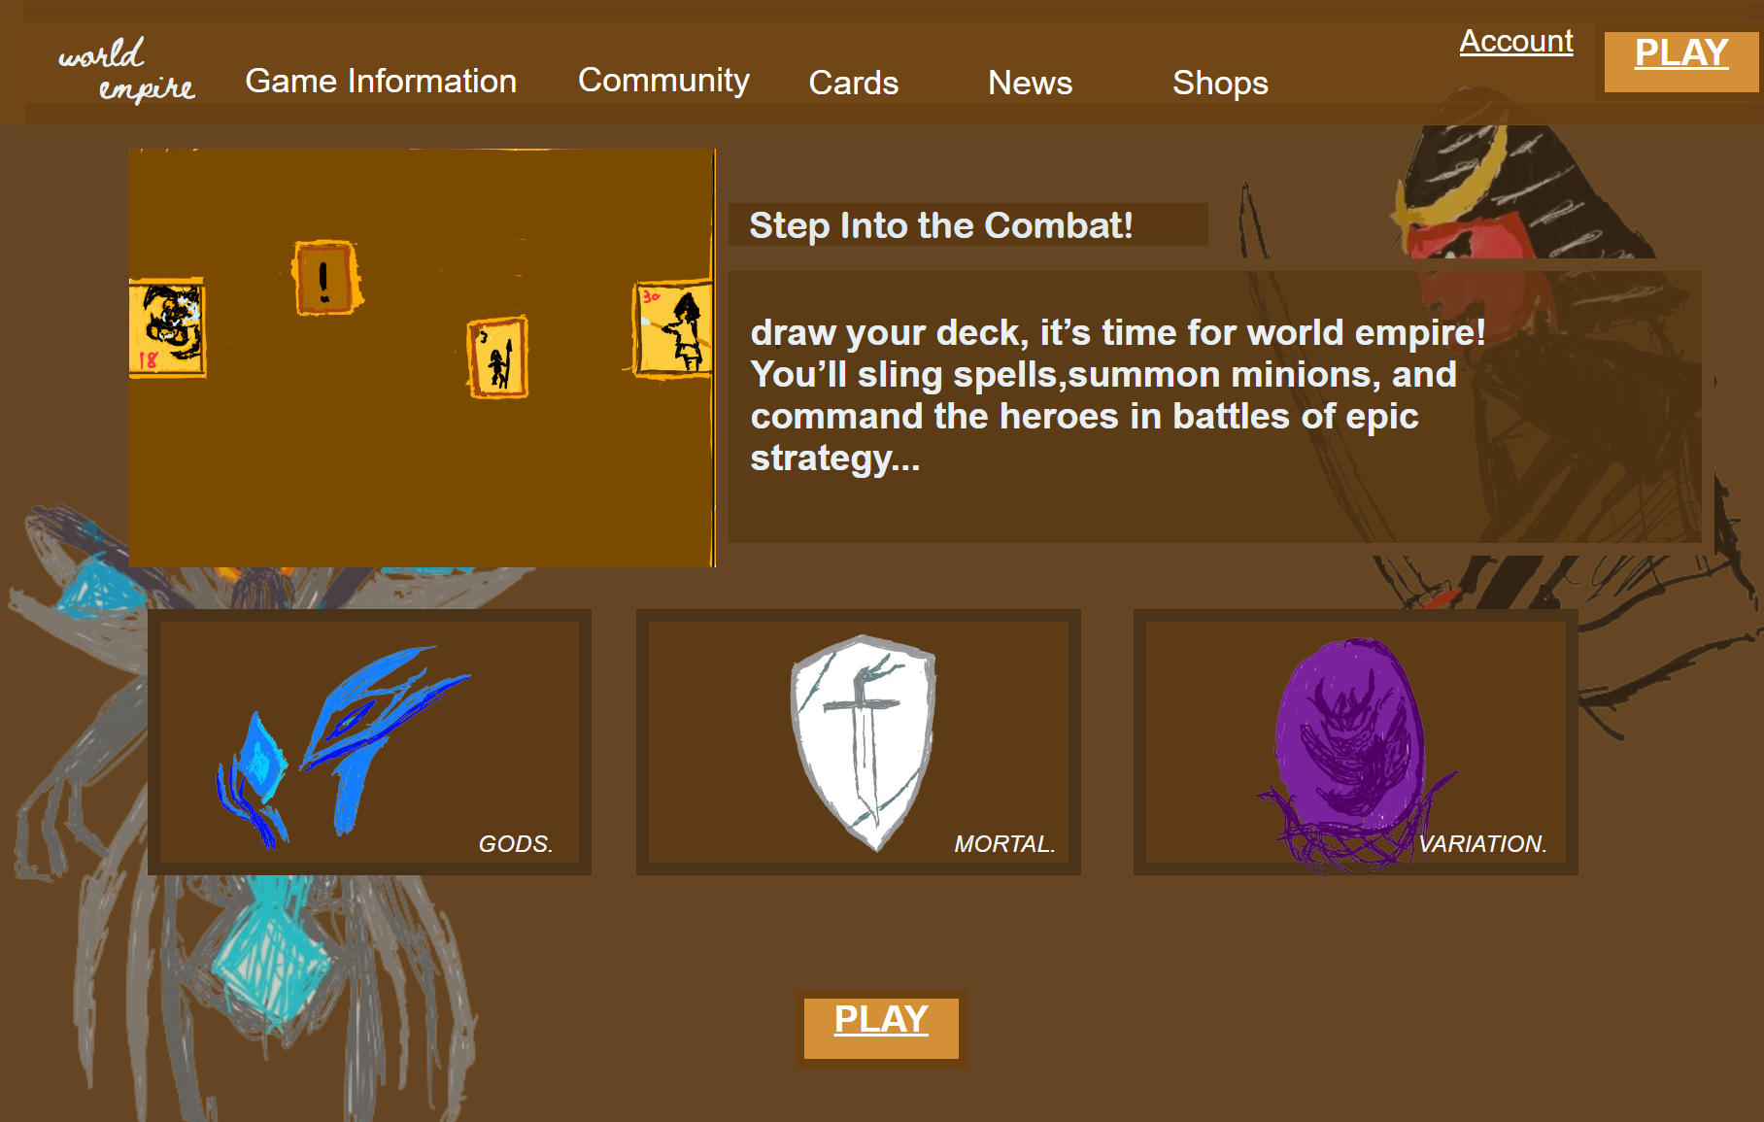
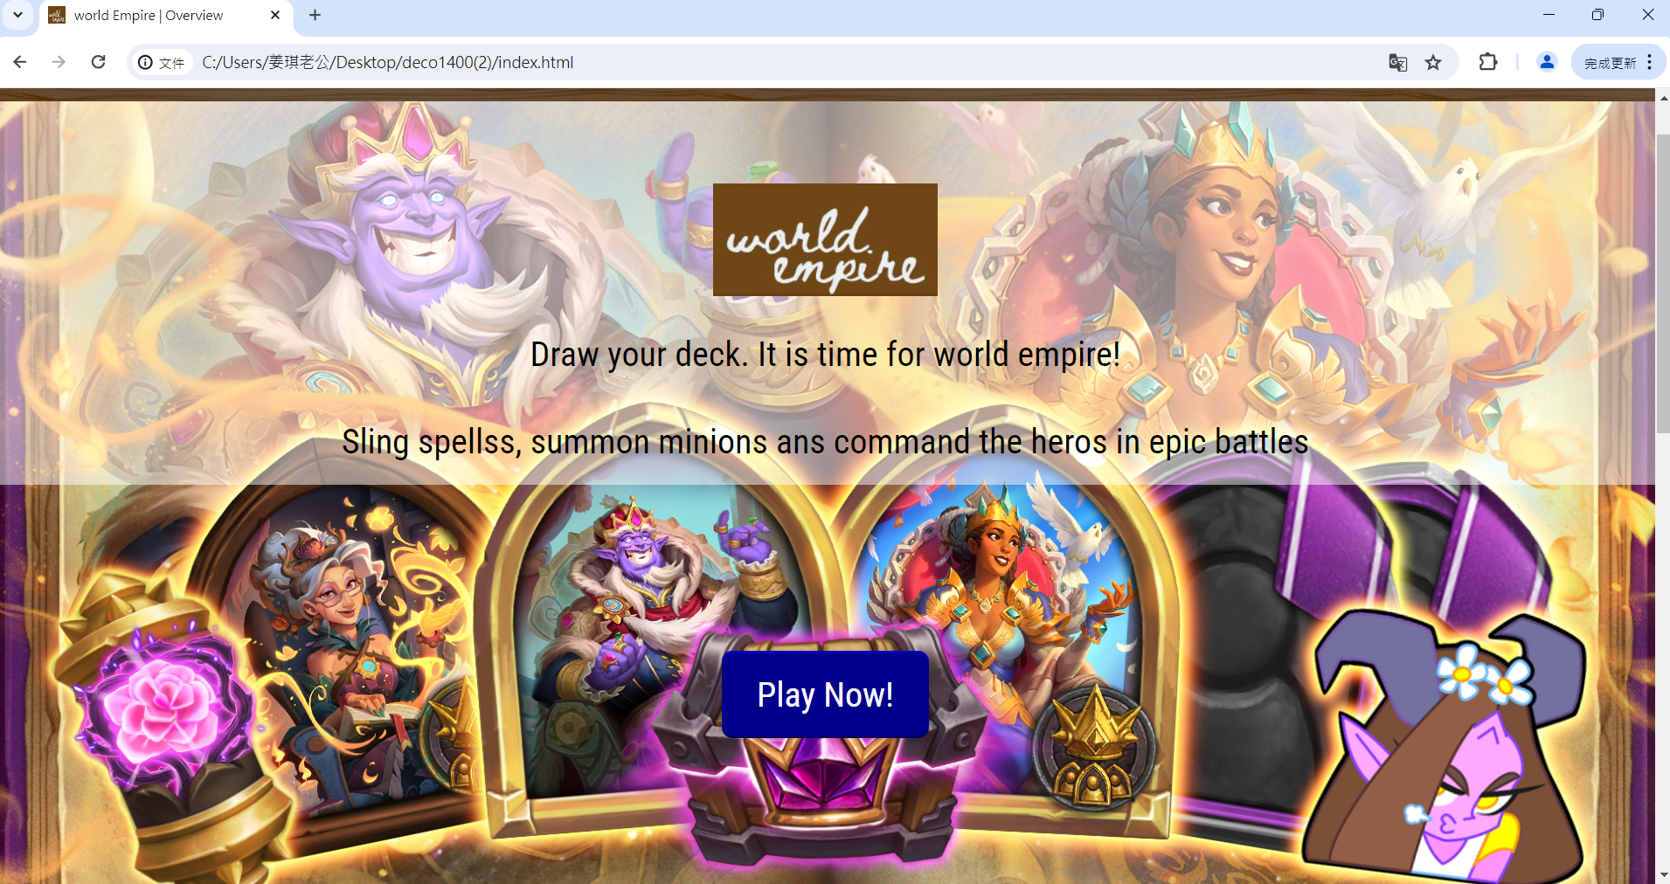
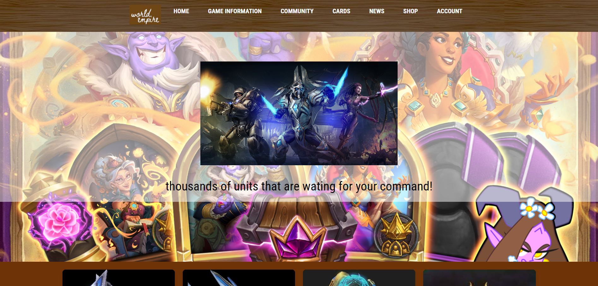
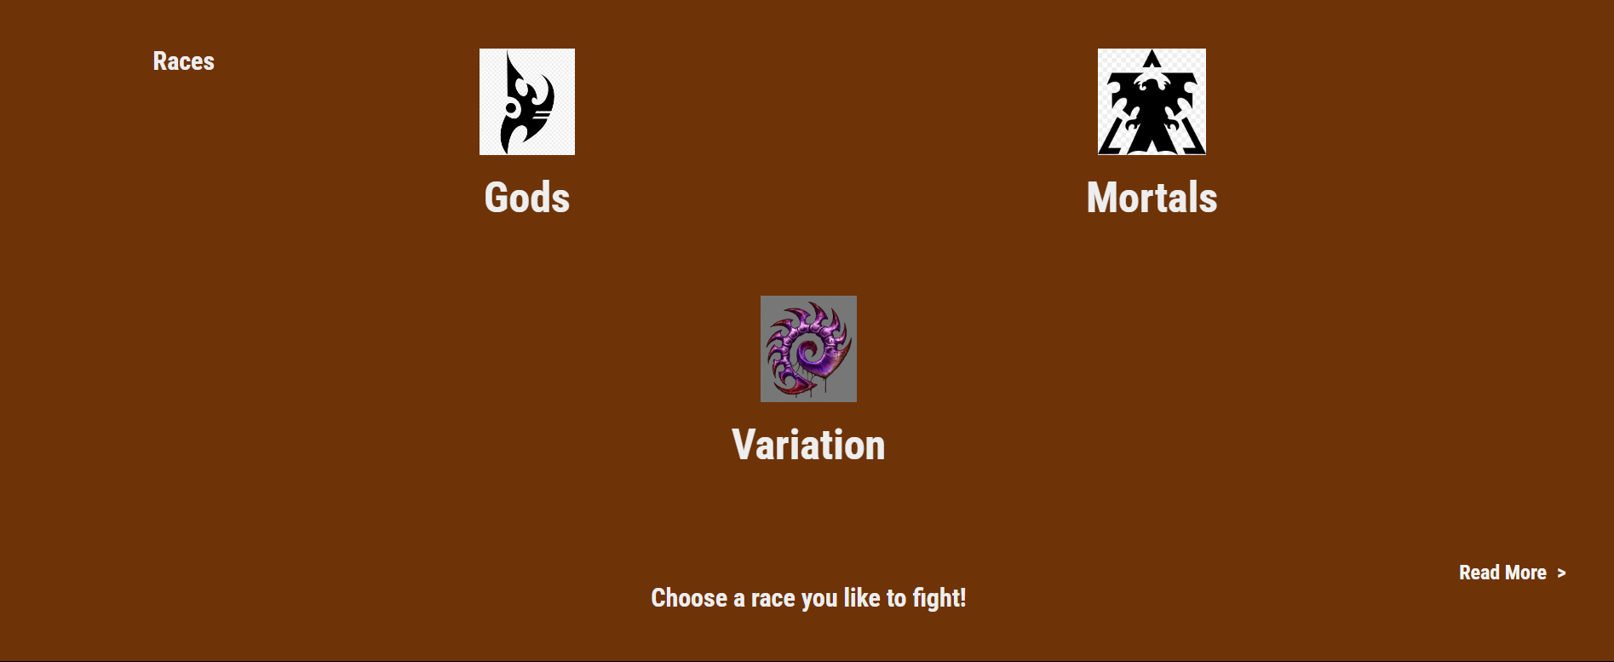
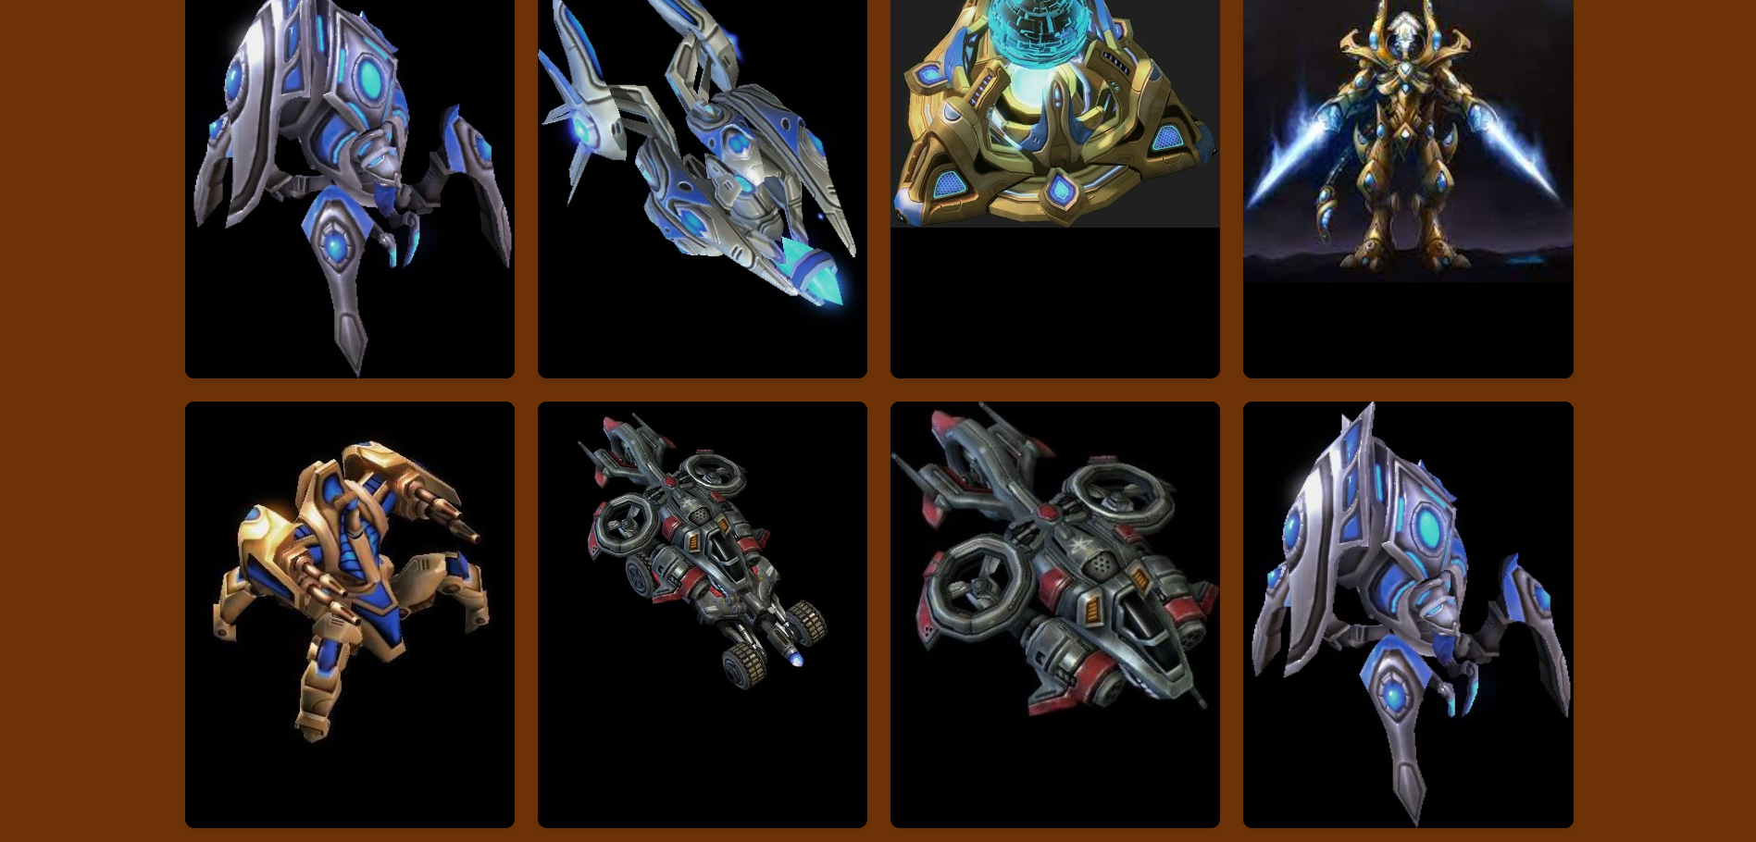
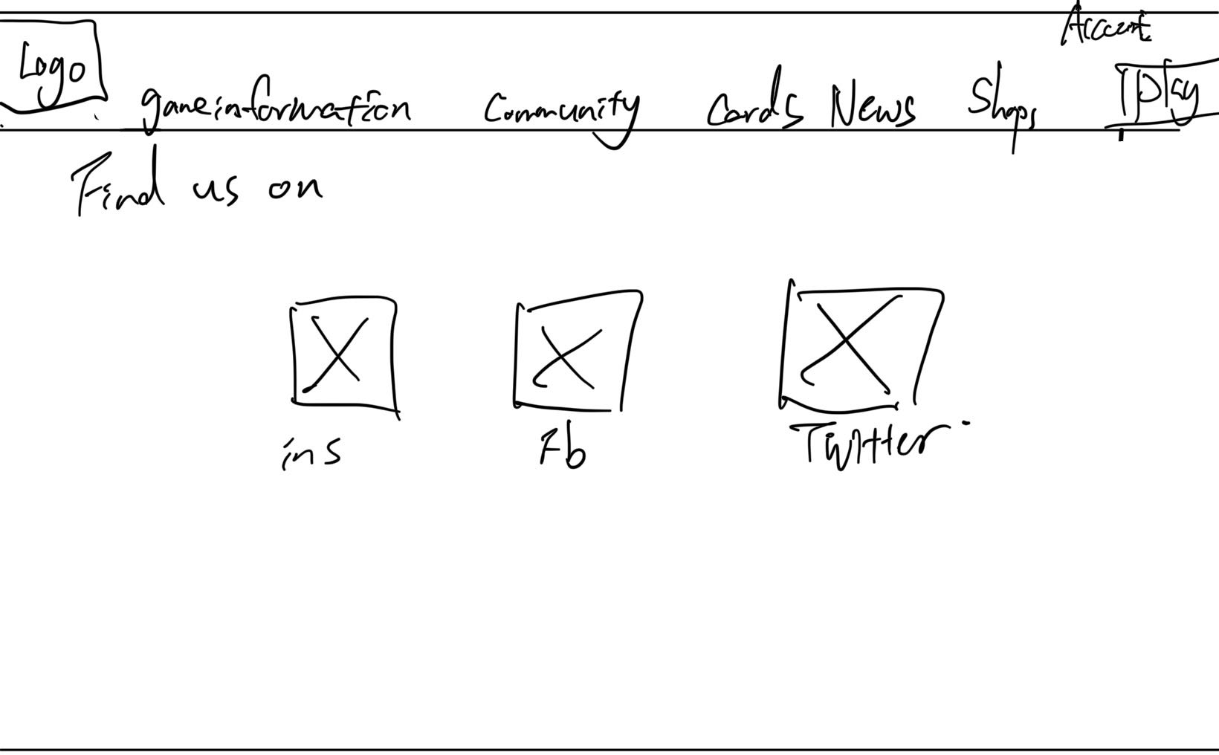
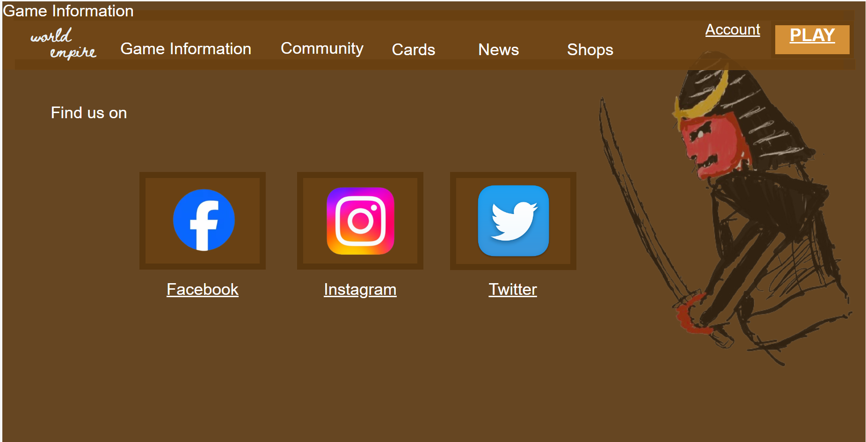

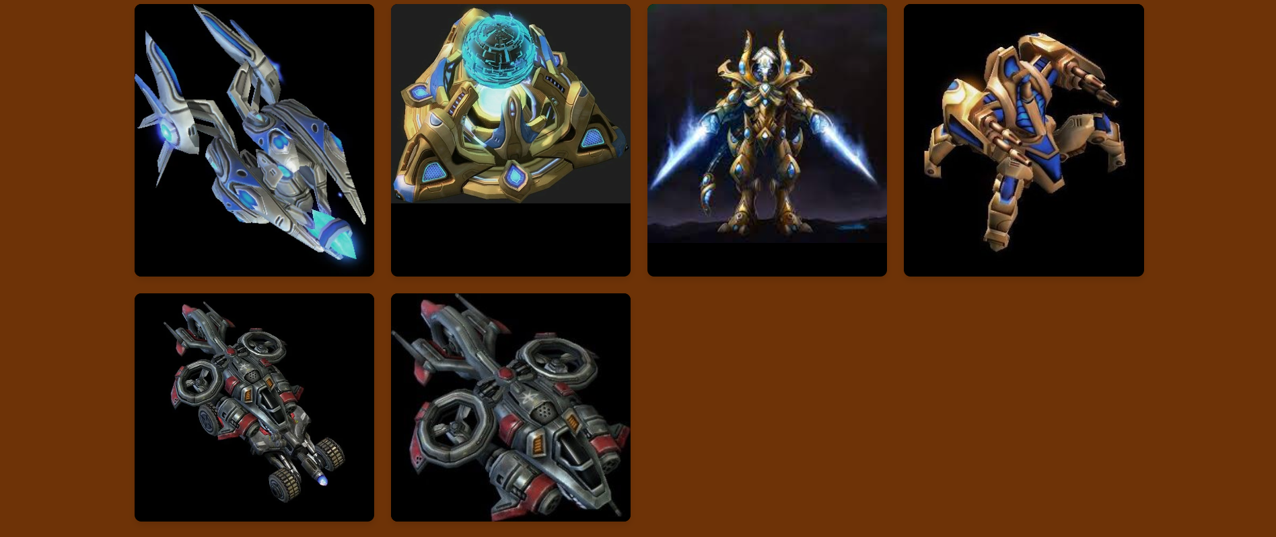
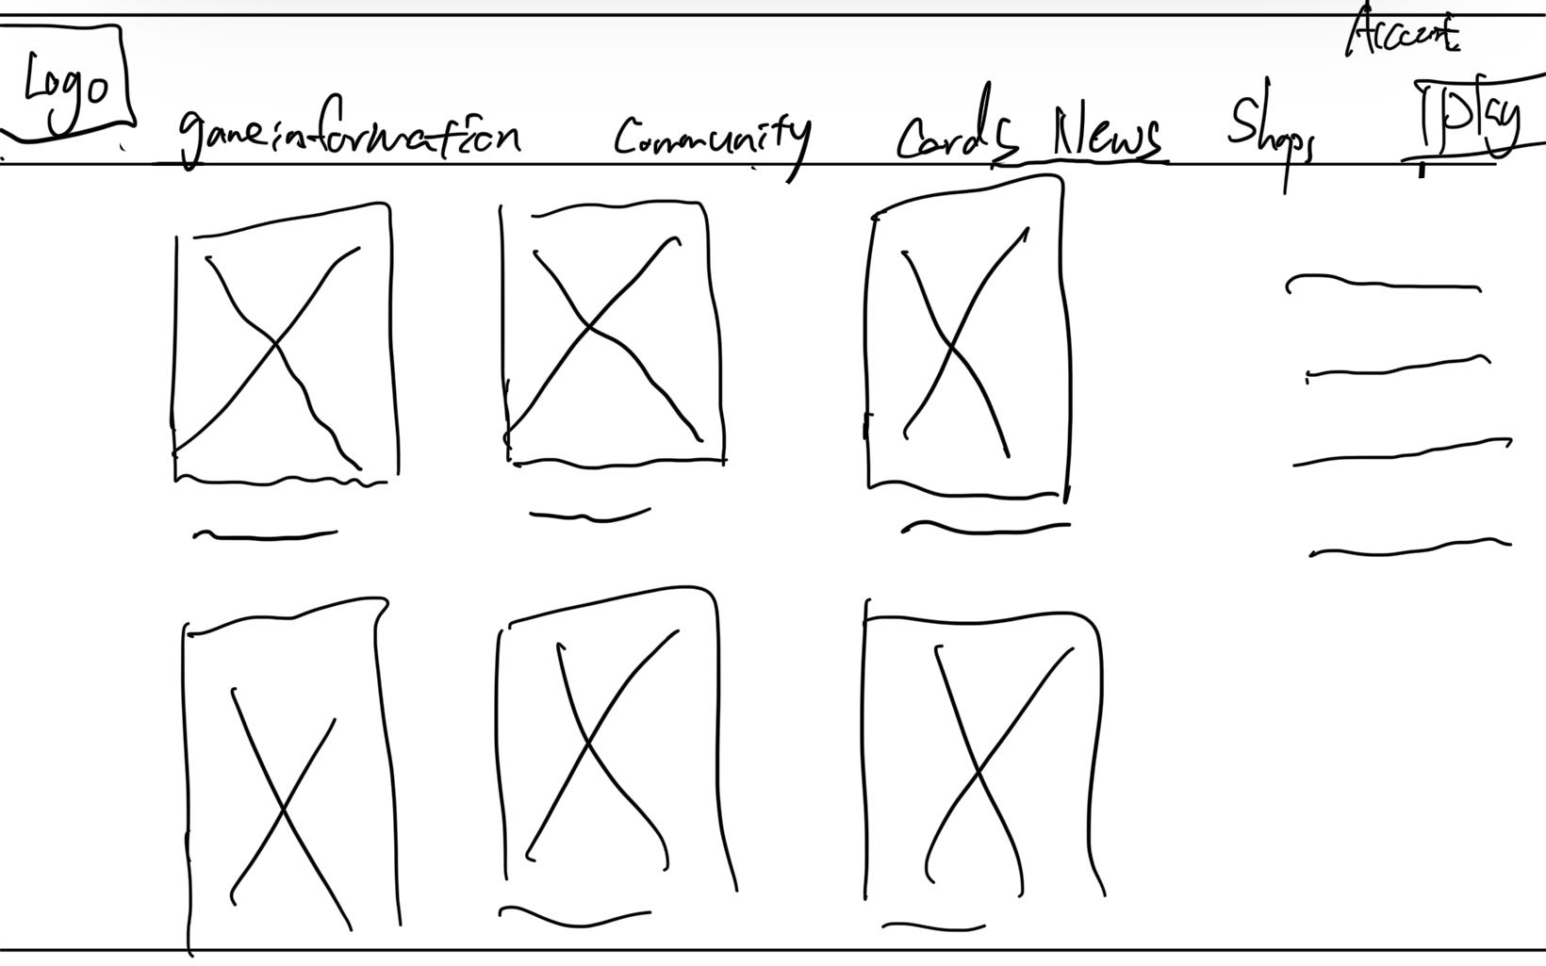
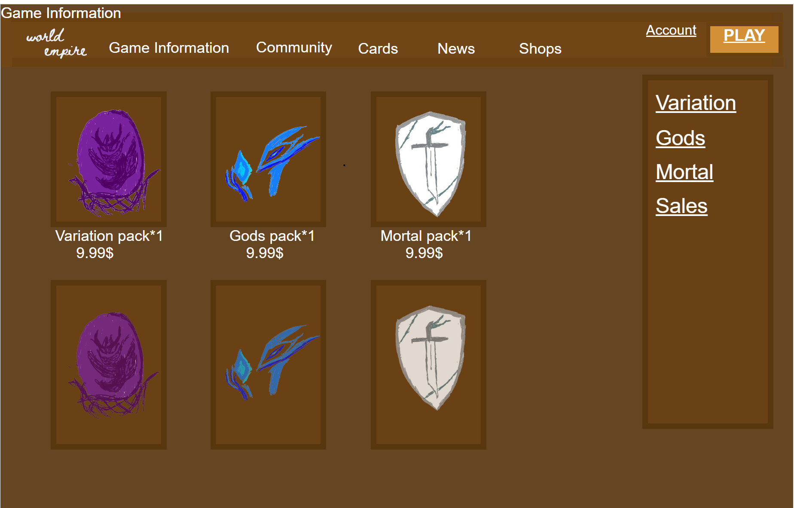
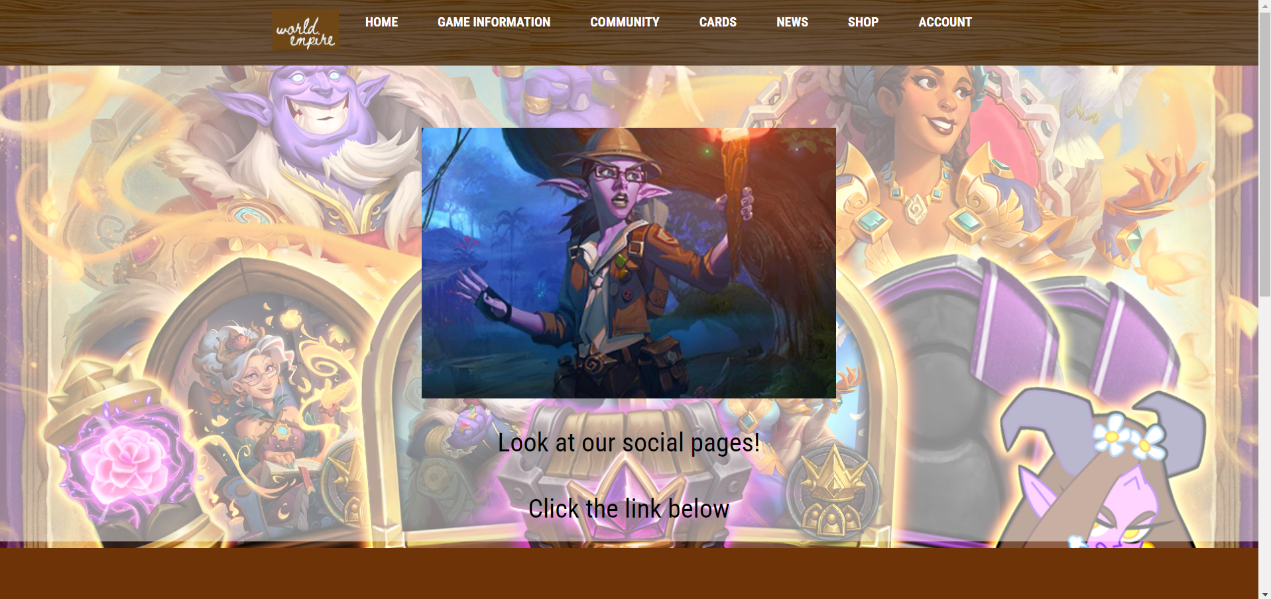
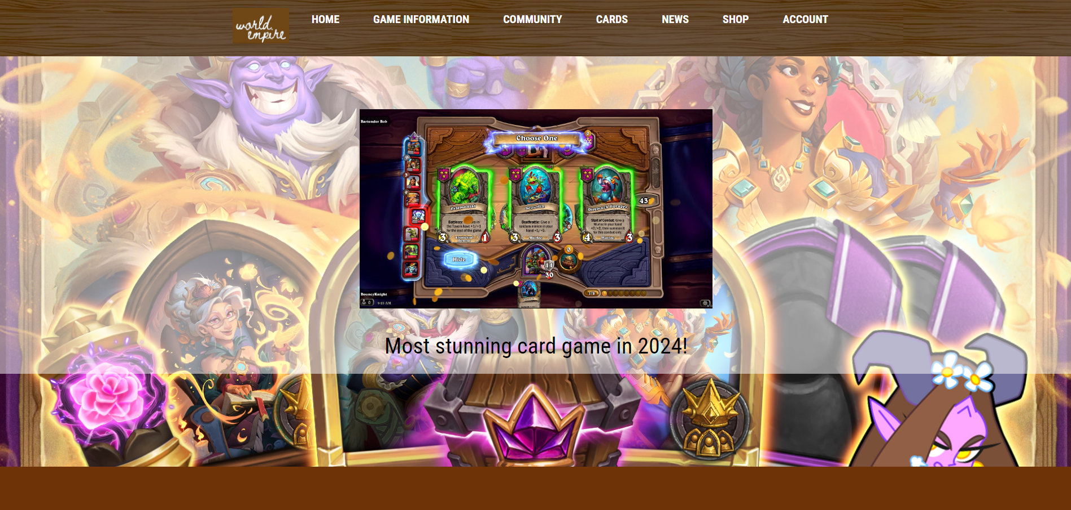
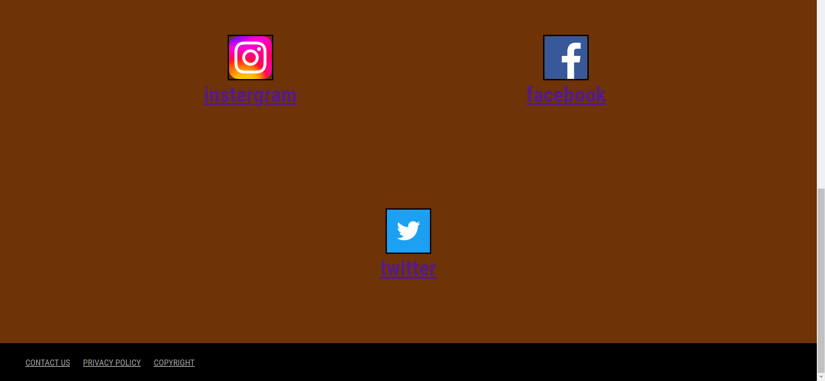
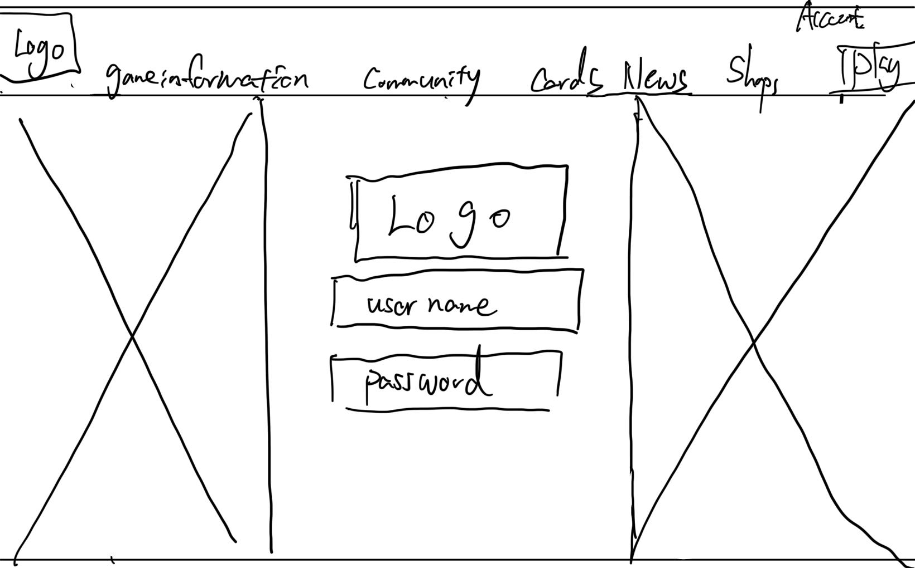
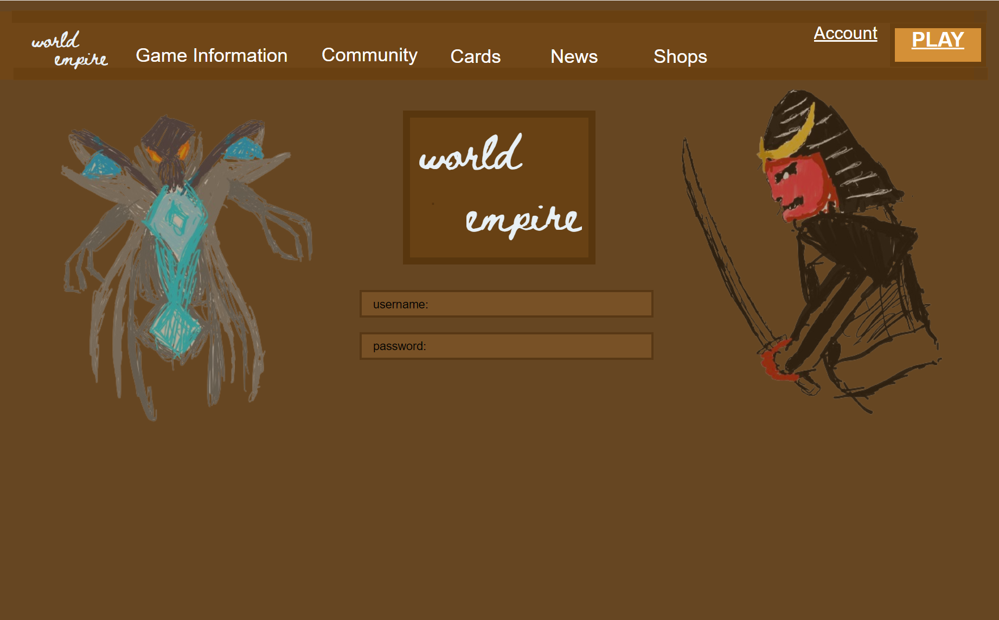
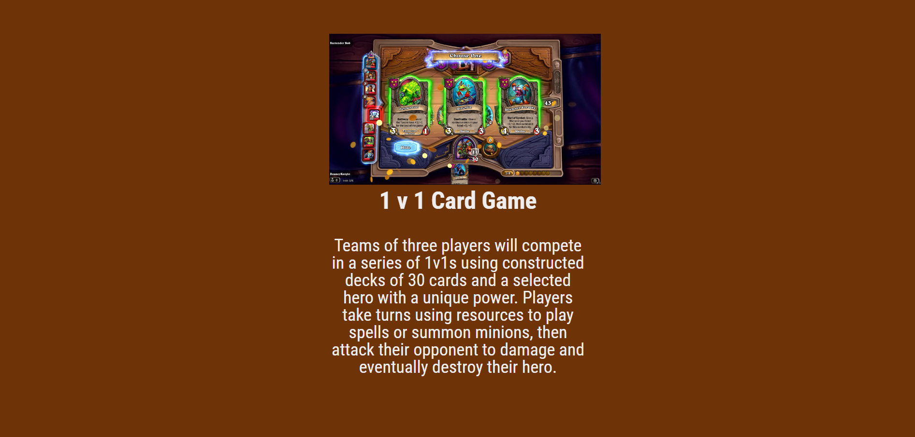
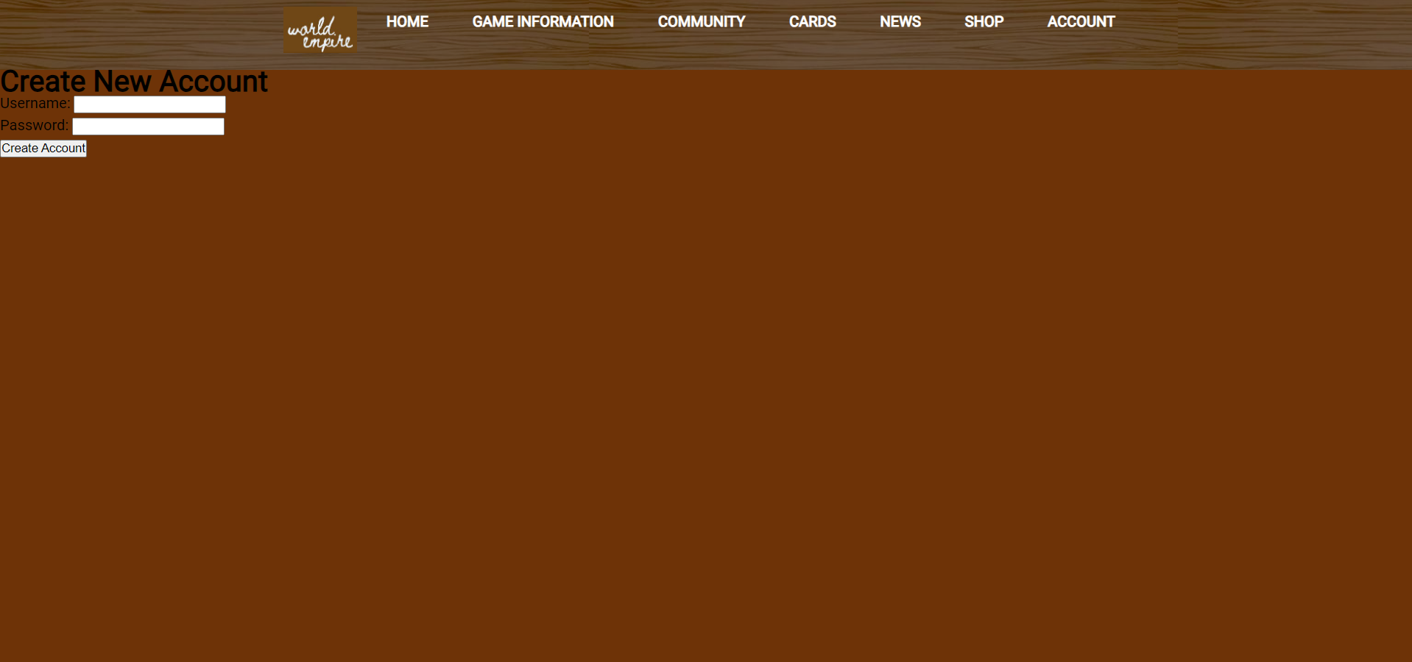
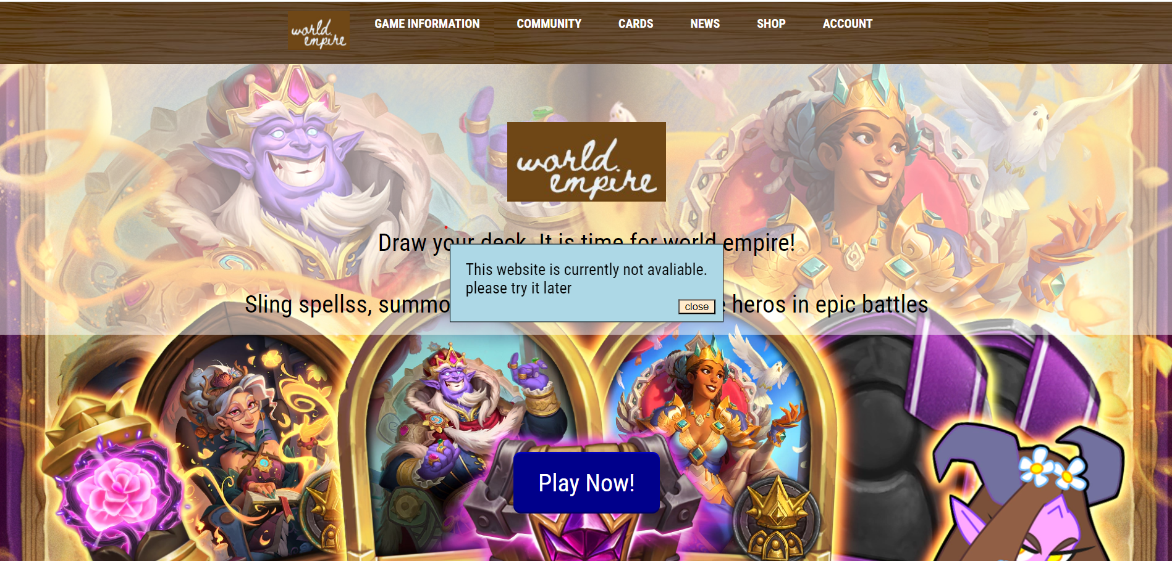
My web design research poster
intro
The website that I am designing is a card game website, and the target group will be people who are the same age as me. The website will be implemented by the DECO1400 course and involved the 10 Nielsen heuristics
prototypes
Website screenshot
reflection
Extra features
After 12 weeks of study, we learned about Nielsen heuristics in lectures and during the tutorial we focused more on coding-based in my final web project I tried to combine both and also, I learned some other techniques while I dived into w3school
At first, I was hard coding everything in HTML because I had no clue about CSS and JS, however, after a while, I started to create images using CSS which links back to HTML.
But I have seen a method to display the image in JavaScript, so I used it in my card library website
My website used 10 Nielsen heuristics at a certain point. For example, I keep my code easy to understand and display text in human language and also the error message will pop out if making a mistake. However, there are still many things that could be improved
There are still many areas and features of my website that could be improved for example making it more interactable which adds some interactive background using Canvas or making the account section work.
There are quite a few things I would like to try in the future. The first is to add the soundtrack to my web design.
This can be done by using HTML audio.
The other thing that might be good to add on my web is the meteor that came out from the top of my page into the bottom, and I think this can be done by Canvas as well as the JavaScript involved
conclusion
To sum everything up. The card game website focuses on teenage groups which use the html CSS JavaScript to achieved. Also To make the code simple, easy to understand and less error-prone following the 10 Nielsen heuristics is important.
The website is looking slightly above the average and many functions could makes it even better

